Slide 1
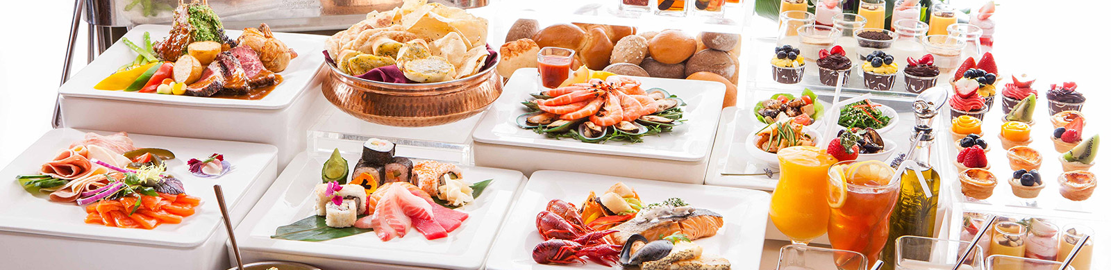
Lecture with Computer Exercises: Modelling and Simulating Social Systems with MATLAB How do participants act during an apéro at ETH?
%add picture
source:kestrel-cam
Emek Barış Küçüktabak, Francesca Sabena, Emile Courthoud, Hangxi Li
Notes:
Hello,
Today me and Francesca will present the research made by HollKamp and Gordon in 1996 about the comparison between piezos and constrained layer damping.

Slide 2
List of Contents
Introduction and Motivation
Description of the Model
Implementation
Simulation
Summary
Source: Pix4D
Notes:
The main objective of the research consists in explaining what was known 20 years ago about piezos,
and this is the first half of the half of the contents of the paper
and the experimental comparison with another solution that was well established, the constrained layer damping treatments
The experiment will be explained by Francesca

Slide 3
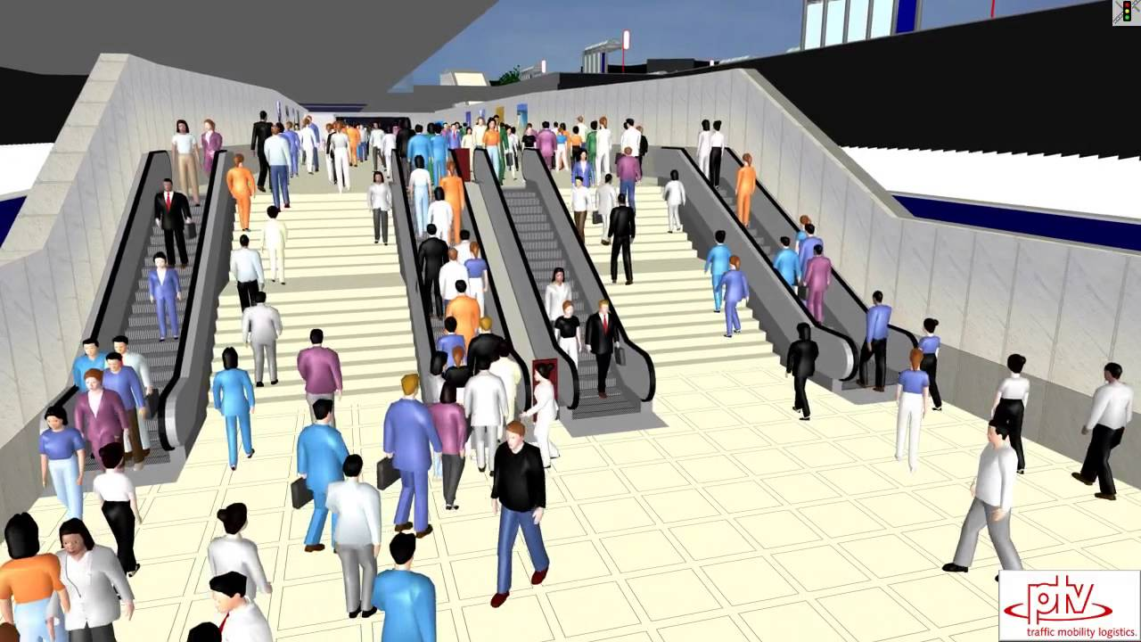
Introduction and Motivation
Pedestrian Traffic
Simulation
Source: Pix4D
https://www.youtube.com/watch?v=UUHFMtR9q9M
Notes:
The main objective of the research consists in explaining what was known 20 years ago about piezos,
and this is the first half of the half of the contents of the paper
and the experimental comparison with another solution that was well established, the constrained layer damping treatments
The experiment will be explained by Francesca

Slide 4
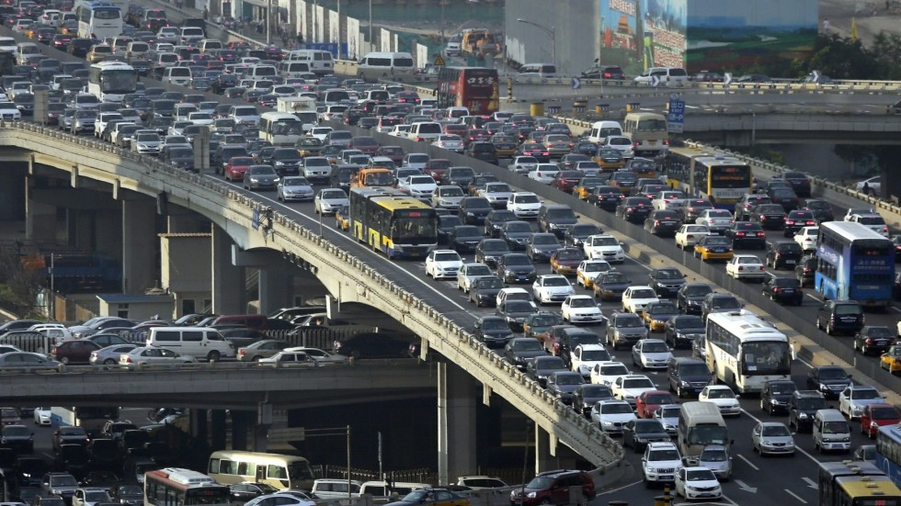
Introduction and Motivation
Car Traffic
Source: Pix4D
Notes:
The main objective of the research consists in explaining what was known 20 years ago about piezos,
and this is the first half of the half of the contents of the paper
and the experimental comparison with another solution that was well established, the constrained layer damping treatments
The experiment will be explained by Francesca

Slide 5
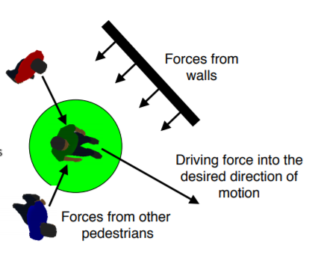
Introduction and Motivation
Social Force Model
Source: Pix4D
Dirk Helbing and Peter Molnar. Social force model for pedestrian dynamics. Phys. Rev. E, 51:4286, May 1995.
Notes:
The main objective of the research consists in explaining what was known 20 years ago about piezos,
and this is the first half of the half of the contents of the paper
and the experimental comparison with another solution that was well established, the constrained layer damping treatments
The experiment will be explained by Francesca

Slide 6
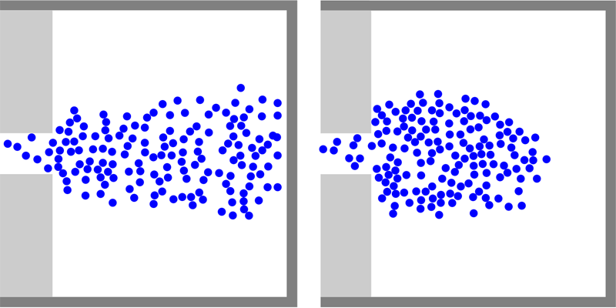
Introduction and Motivation
Source: Pix4D
SEITZ, Michael J. et al. The Superposition Principle: A Conceptual Perspective on Pedestrian Stream Simulations.Collective Dynamics, [S.l.], v. 1, p. 1-19, mar. 2016. ISSN 2366-8539. Available at: <https://collective-dynamics.eu/index.php/cod/article/view/A2>.
Notes:
The main objective of the research consists in explaining what was known 20 years ago about piezos,
and this is the first half of the half of the contents of the paper
and the experimental comparison with another solution that was well established, the constrained layer damping treatments
The experiment will be explained by Francesca

Slide 7
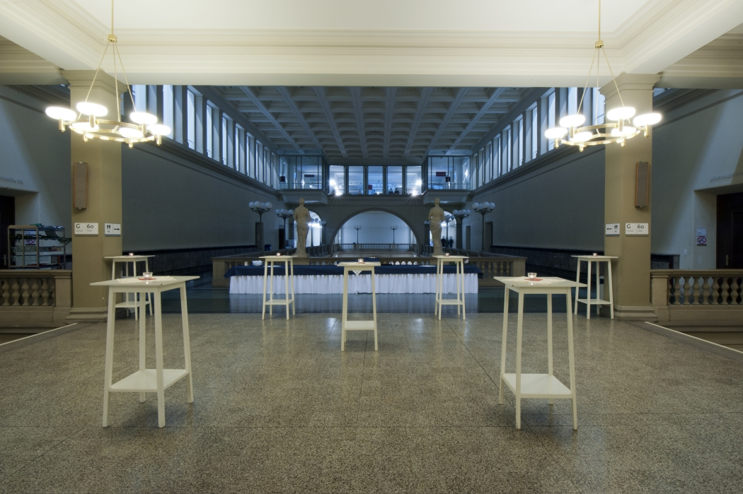
Introduction and Motivation
Apero in ETH
Source: Pix4D
Notes:
The main objective of the research consists in explaining what was known 20 years ago about piezos,
and this is the first half of the half of the contents of the paper
and the experimental comparison with another solution that was well established, the constrained layer damping treatments
The experiment will be explained by Francesca

Slide 8
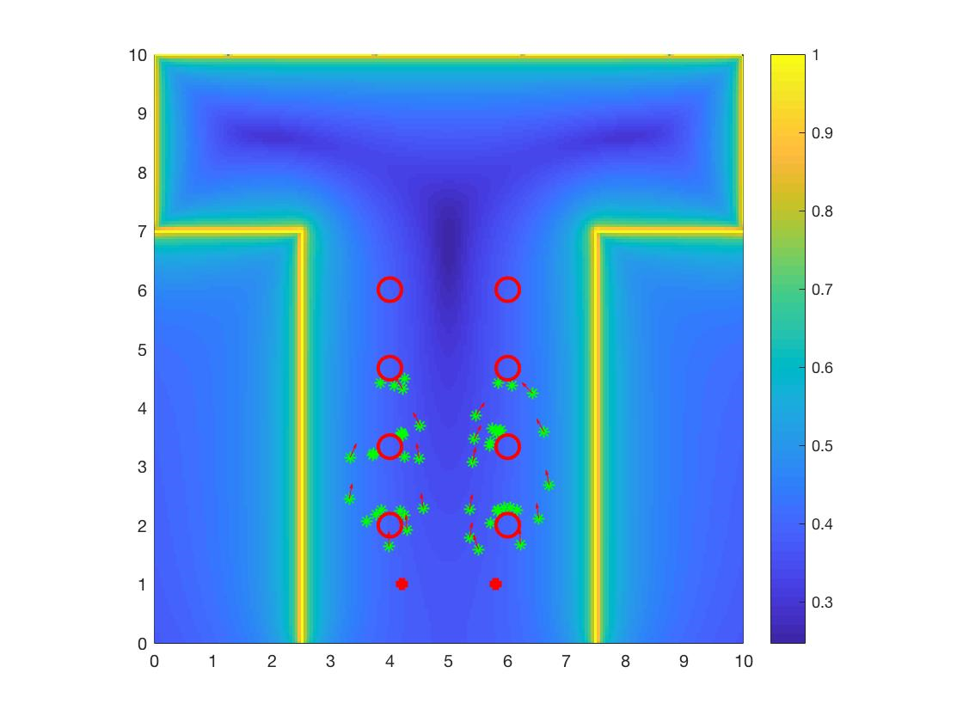
Introduction and Motivation
Number of People
Distance between Food Locations
Tables’ Disposition
Affect the behavior of the participants ?
Source: Pix4D
Social Force Model
Notes:
The main objective of the research consists in explaining what was known 20 years ago about piezos,
and this is the first half of the half of the contents of the paper
and the experimental comparison with another solution that was well established, the constrained layer damping treatments
The experiment will be explained by Francesca

Slide 9



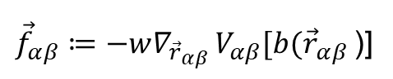

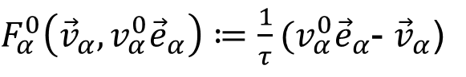

Description of the Model
Force due to Destination
Considering a pedestrian alfa:
Force due to other pedestrians
Monotonic decreasing force field with elliptical shape
$$v_{α}^{0}{\vec{e}}_{α}$$
$F_{α}^{0}\left({\vec{v}}_{α},v_{α}^{0}{\vec{e}}_{α}\right)≔\frac{1}{τ}(v_{α}^{0}{\vec{e}}_{α}$- ${\vec{v}}_{α}$)
$${\vec{v}}_{α}$$
$$F_{α}^{0}$$
Source: Pix4D
$${\vec{v}}_{α}$$
${\vec{f}}_{αβ}≔−w∇_{{\vec{r}}_{αβ }}V_{αβ}[b({\vec{r}}_{αβ }$)]
$$2b≔\sqrt{{\left(\left\|{\vec{r}}_{αβ }\right\|+\left\|{\vec{r}}_{αβ }−v_{β}∆t{\vec{e}}_{β}\right\|\right)}^{2}−{\left(v_{β}∆t\right)}^{2}}$$
with
Dirk Helbing and Peter Molnar. Social force model for pedestrian dynamics. Phys. Rev. E, 51:4286, May 1995.
Notes:
The main objective of the research consists in explaining what was known 20 years ago about piezos,
and this is the first half of the half of the contents of the paper
and the experimental comparison with another solution that was well established, the constrained layer damping treatments
The experiment will be explained by Francesca

Slide 10
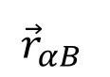


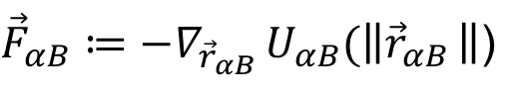
Description of the Model
Force due to obstacles and walls
Monotonically decreasing force field
Total Force
Summation of all forces
$${\vec{r}}_{αB }$$
${\vec{F}}_{αB}≔−∇_{{\vec{r}}_{αB }}U_{αB}(\left\|{\vec{r}}_{αB }\right\|$)
$${\vec{F}}_{αB}$$
Source: Pix4D
$${\vec{F}}_{α}\left(t\right)≔F_{α}^{0}\left({\vec{v}}_{α},{\vec{v}}_{α}^{0}{\vec{e}}_{α}\right)+\sum_{β}{{\vec{f}}_{αβ}}+\sum_{B}{{\vec{F}}_{αB}}$$
Dirk Helbing and Peter Molnar. Social force model for pedestrian dynamics. Phys. Rev. E, 51:4286, May 1995.
Notes:
The main objective of the research consists in explaining what was known 20 years ago about piezos,
and this is the first half of the half of the contents of the paper
and the experimental comparison with another solution that was well established, the constrained layer damping treatments
The experiment will be explained by Francesca

Slide 11
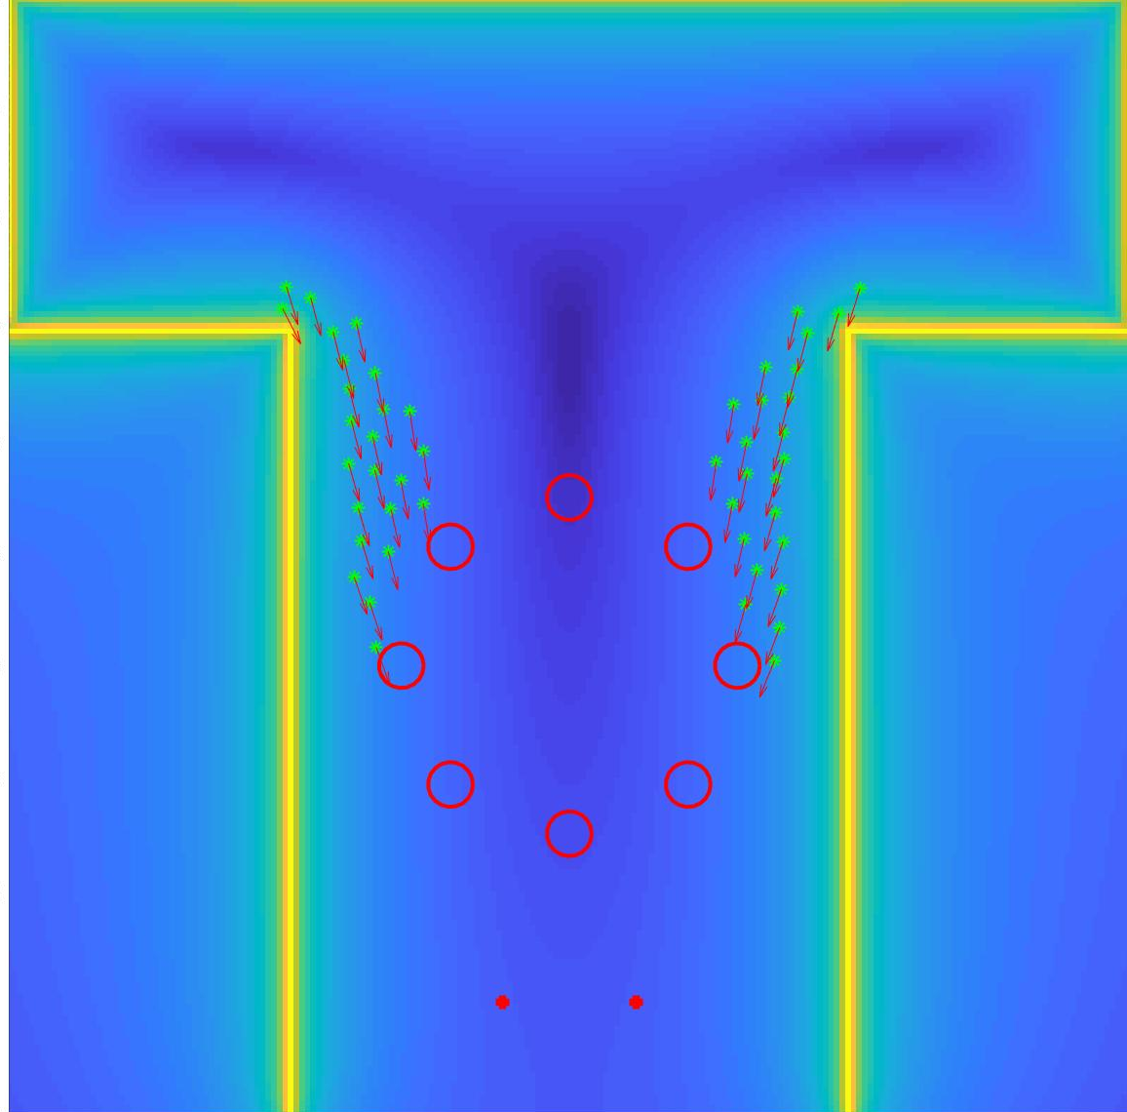
For what concerns the implementation, I’ll first explain the organization of the apero room.
As you can see from the picture, the room has a T shape. Every simulation, people are initially distributed in the two top-left and top-right corners of the room.
The buffet tables are 2, and they are at the bottom.
Once the people get some food, they move to the tables in the centre. We have analysed two table configurations, circular and rectangular.
Implementation
Initial position of tables, people and food points
Two table configurations: rectangular and circular dispositions.
The people are initially located on the top-left and top-right of the map.
The position of the tables where the food is distributed are two and they are located on the bottom of the room.
Notes:
The main objective of the research consists in explaining what was known 20 years ago about piezos,
and this is the first half of the half of the contents of the paper
and the experimental comparison with another solution that was well established, the constrained layer damping treatments
The experiment will be explained by Francesca

Slide 12
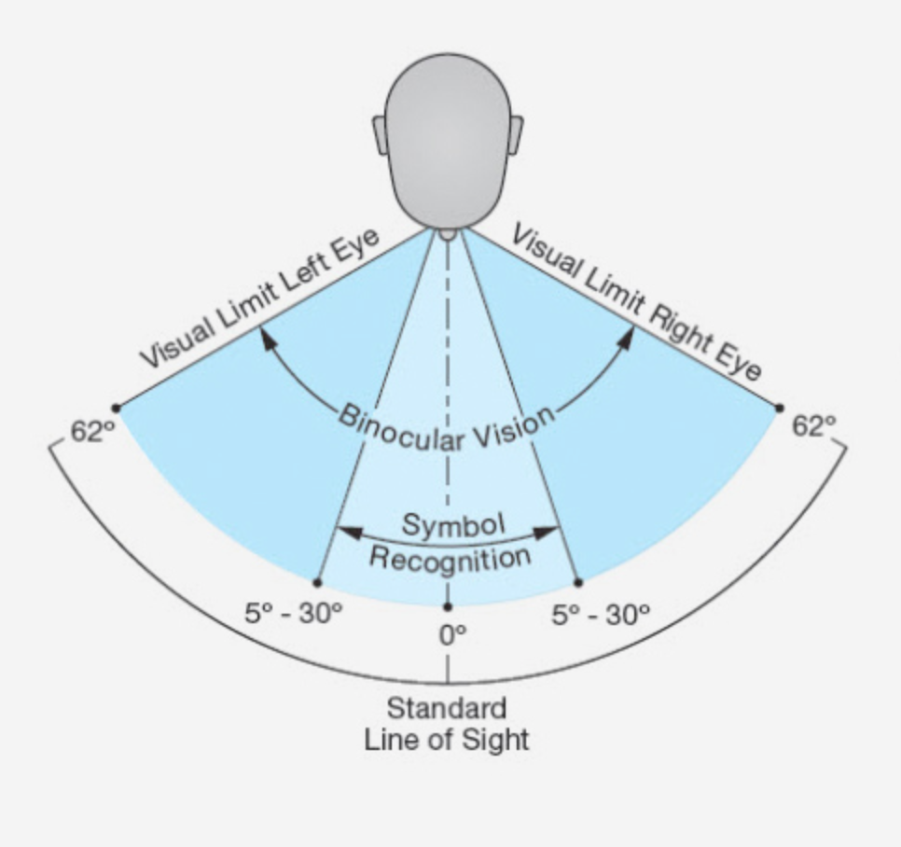



Now, coming back to the force, we explained in the social force model it was advised to use monotonically decreasing functions.
In our model, the interaction between a person and the other people is described by an exponential function. The parameters assume the same values the researcher have used in the social force model
(A=2N, B=0.1 per meter)
The visual field spans for 60 degrees. If a person is outside the visual field, for example behind him, the force drops to 30%
Implementation
Person-people repulsive force
Exponential force that decreases with the distance among pedestrians.
$A=2 N$
$B=0.1 1/m$
$φ=60°$ visual field
$${\vec{F}}_{αB}={ωAe}^{b/B}$$
$$ω\left(\vec{e}∙\vec{f}\right)=\left\{\begin{aligned}1 if \vec{e}∙\vec{f}≥\left\|\vec{f}\right\| cos⁡(φ) \\ 0.3 otherwise \end{aligned}\right.$$
Notes:
The main objective of the research consists in explaining what was known 20 years ago about piezos,
and this is the first half of the half of the contents of the paper
and the experimental comparison with another solution that was well established, the constrained layer damping treatments
The experiment will be explained by Francesca

Slide 13

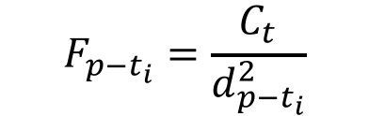
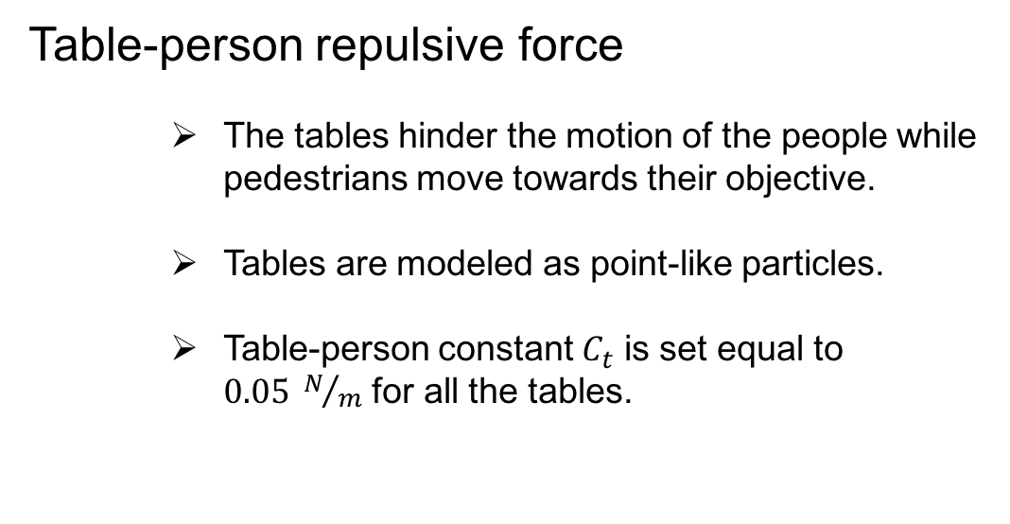
The table-person repulsive force is inversely proportional to the distance between tables and people.
Since table have a circular shape, they are modeled as point-like sources of forces.
Ct, the table-person constant, is set to 0.05 and the forces generated by the tables are superimposed.
Implementation
Table-person repulsive force
The tables hinder the motion of the people while pedestrians move towards their objective.
Tables are modeled as point-like particles.
Table-person constant $C_{t}$ is set equal to $0.05 N/m$ for all the tables.
$${\vec{F}}_{p−t}=\sum_{t_{i}=1}^{Nt}{{\vec{F}}_{p−t_{i}}}$$
$$F_{p−t_{i}}=\frac{C_{t}}{d_{p−t_{i}}^{2}}$$
Notes:
The main objective of the research consists in explaining what was known 20 years ago about piezos,
and this is the first half of the half of the contents of the paper
and the experimental comparison with another solution that was well established, the constrained layer damping treatments
The experiment will be explained by Francesca

Slide 14
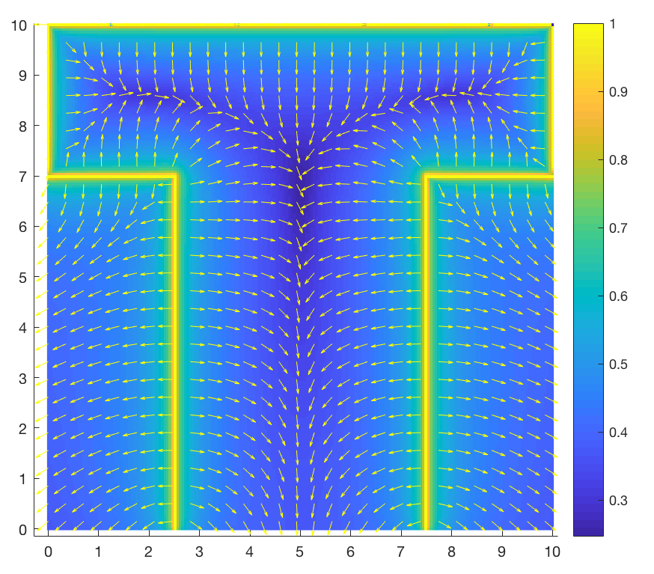

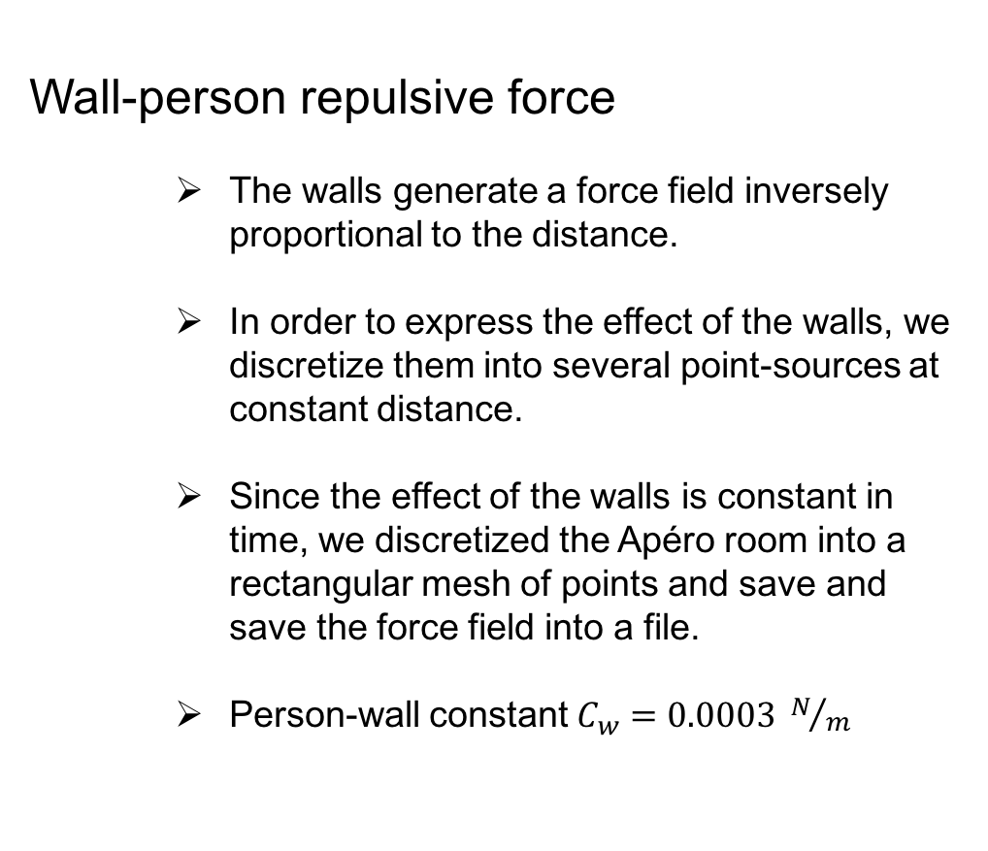

The table-person repulsive force is inversely proportional to the distance between tables and people.
Since table have a circular shape, they are modeled as point-like sources of forces.
Ct, the table-person constant, is set to 0.05 and the forces generated by the tables are superimposed.
Implementation
Wall-person repulsive force
The walls generate a force field inversely proportional to the distance.
In order to express the effect of the walls, we discretize them into several point-sources at constant distance.
Since the effect of the walls is constant in time, we discretized the Apéro room into a rectangular mesh of points and save and save the force field into a file.
Person-wall constant $C_{w}=0.0003 N/m$
Source: Pix4D
$$F_{p−w_{i}}=\frac{C_{w}}{d_{p−w_{i}}^{2}}$$
$${\vec{F}}_{p−w}=\sum_{w_{i}=1}^{Nw}{{\vec{F}}_{p−w_{i}}}$$

Slide 15

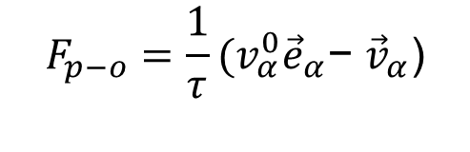
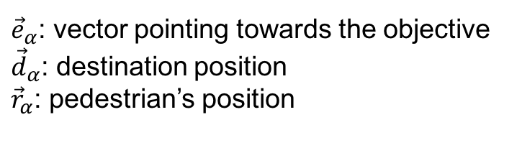
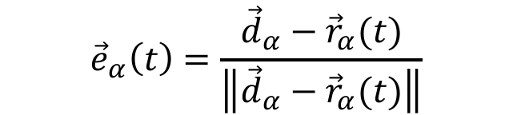
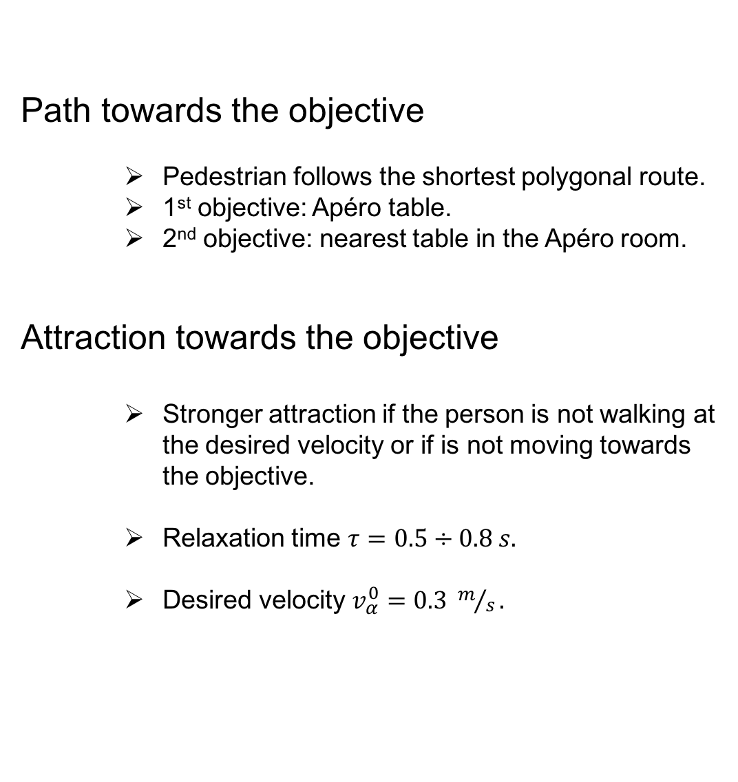
Path towards the objective
Pedestrian follows the shortest polygonal route.
1st objective: Apéro table.
2nd objective: nearest table in the Apéro room.
Attraction towards the objective
Stronger attraction if the person is not walking at the desired velocity or if is not moving towards the objective.
Relaxation time $τ=0.5÷0.8 s.$
Desired velocity $v_{α}^{0}=0.3 m/s.$
Implementation
$${\vec{e}}_{α}\left(t\right)=\frac{{\vec{d}}_{α}−{\vec{r}}_{α}(t)}{\left\|{\vec{d}}_{α}−{\vec{r}}_{α}(t)\right\|}$$
${\vec{e}}_{α}$: vector pointing towards the objective
${\vec{d}}_{α}$: destination position
${\vec{r}}_{α}$: pedestrian’s position
$$F_{p−o}=\frac{1}{τ}(v_{α}^{0}{\vec{e}}_{α}\text{− }{\vec{v}}_{α}\text{)}$$
$v_{α}^{0}$: desired velocity
$τ$: relaxation time
${\vec{v}}_{α}$: actual velocity

Slide 16

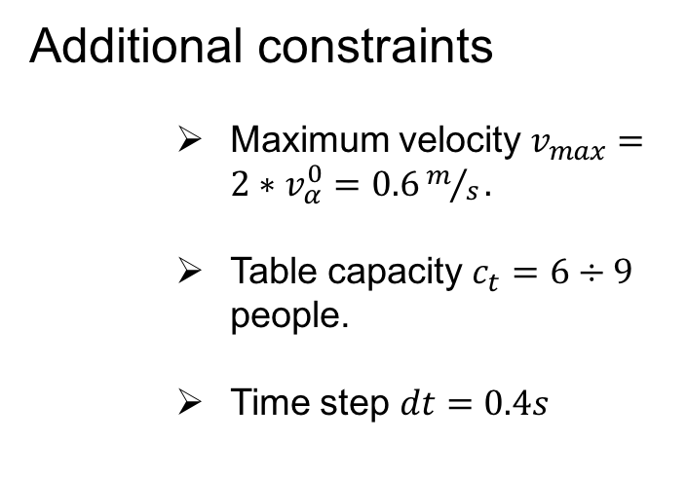
Implementation
Additional constraints
Maximum velocity $v_{max}=2∗v_{α}^{0}=0.6m/s\text{.}$
Table capacity $c_{t}=6÷9$ people.
Time step $dt=0.4s$
Source: Pix4D

Slide 17
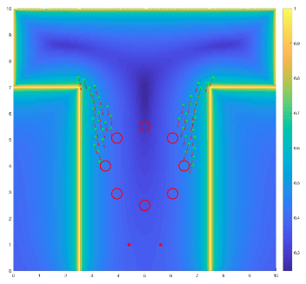
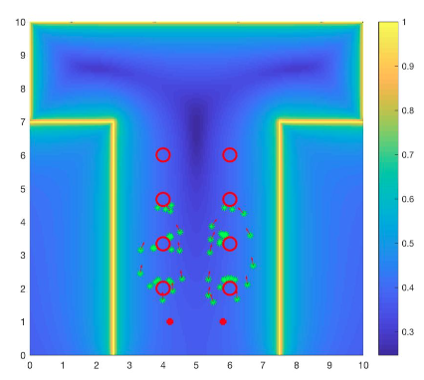
Simulation
3 functions are used to consider the cost of every simulations:
Time cost function
Velocity cost function
Force cost function
Simulation conducted by averaging different simulations over 20 attemps each.
The parameters that changed are:
Number of participants
Number of tables
Disposition of tables (circular or rectangular)
Distance between food positions on the buffet table
Source: Pix4D

Slide 18
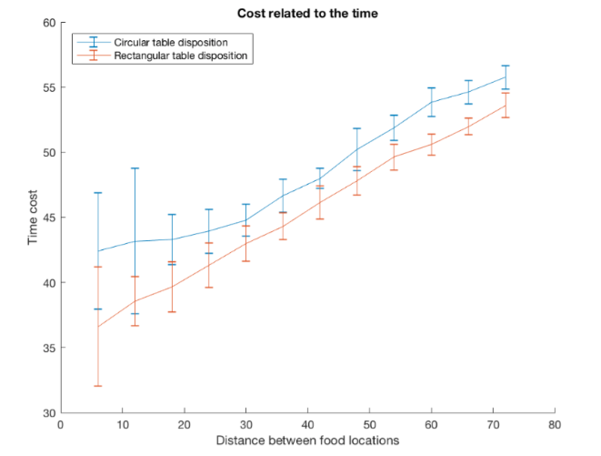
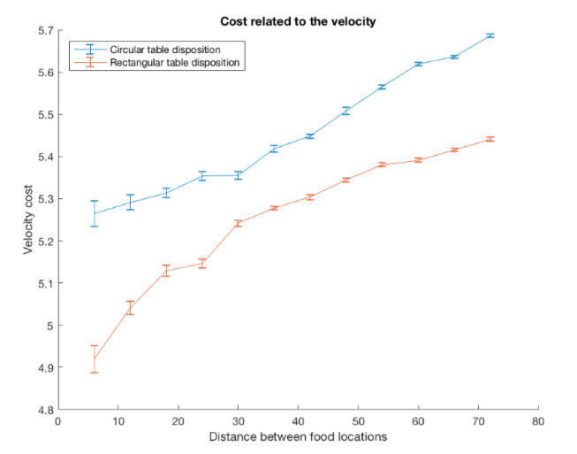
Simulation
Changing the number of participants
Number of people: from 6 to 72
Number of tables: 8
Capacity of tables:9
Distance between food points: 1
Results
Linear increase of time cost with increasing number of participants
Rectangular table disposition is preferred with respect to the circular table disposition
Rectangular table disposition:
the velocity cost is insignificant in case of few participants.
Clusters begin around 15 people
Stable situation in case of crowded apéros
Source: Pix4D

Slide 19
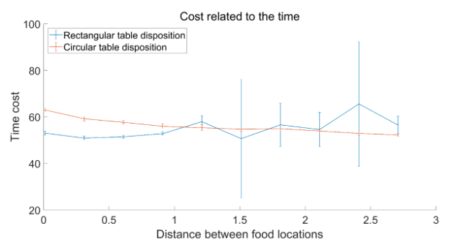
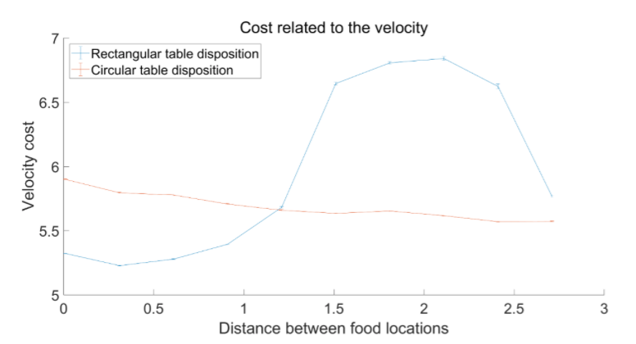
Simulation
Changing the food positions
Distance between food points: from 0 to 2.7
Number of tables: 8
Capacity of tables: 9
Number of people: 72
Results
Cost of time has no significant correlation with the distance of food points
Cost of velocity
Circle: decreases monotonously
Rectangle: down-”U”shape
Source: Pix4D

Slide 20
Summary
Description of Social Force Model
Implementation: person-person, table-person, wall-person, objective destination change.
Time cost function increase as number of people increase.
Rectangular table disposition is better than circular one.
Food points separates as far as possible for circle arrangement of table, a bit for rectangular arrangement.
Source: Pix4D

Slide 21
Thank you
Source: Pix4D

